Slide 1
Changing 4-6yo’s means/outcome verb biases within and across domains
Melissa Kline, Annelot de Rechteren van Hemert & Jesse Snedeker

Slide 2
She ran into the room Manner
She entered the room running Path
She flattened the can with a hammer Action
She hammered the can flat Effect

Slide 3
Frequencies of verb type vary across languages
Biases change with training
Adult biases carry over between domains
Suggests that verb semantics involves a more general representation of means vs. outcome
Young babies also care about this distinction in nonlinguistic contexts
(Talmy 1985, Levin & Rappaport Hovav 2010) (Shafto, Havasi & Snedeker 2014) (Geojo 2014) (Csibra & Gergely 2007)

Slide 4
Do young children use ‘umbrella’ means/outcome representations to predict verb meaning?

Slide 5
Experiment 1

Slide 6
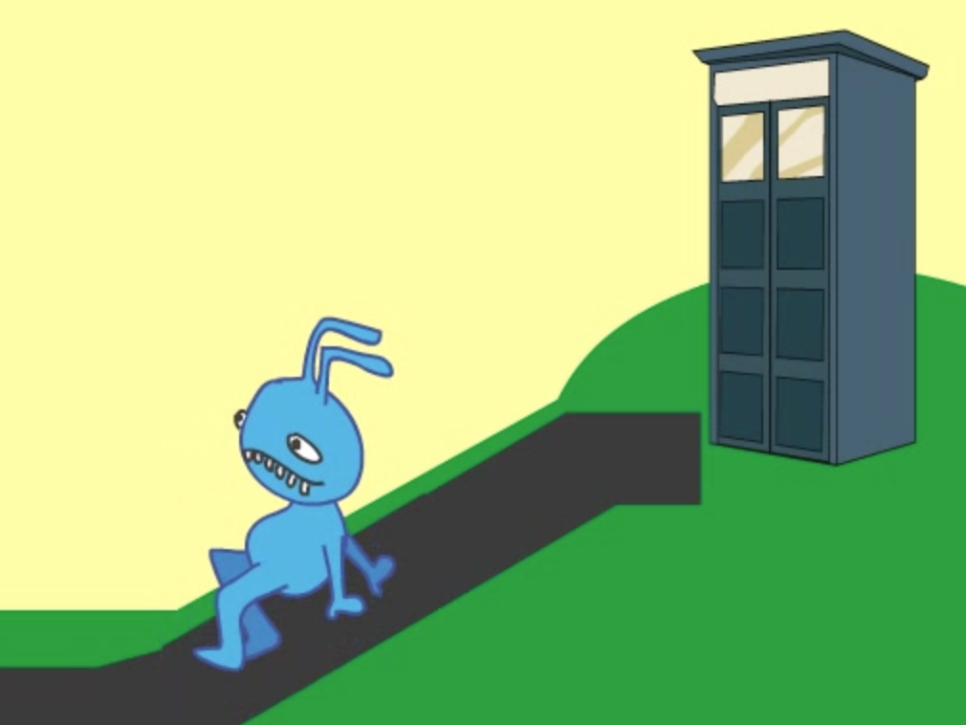
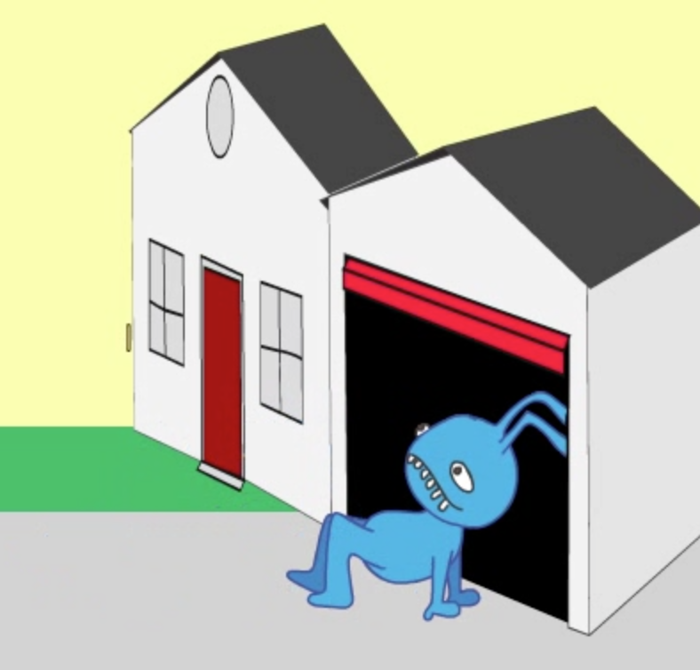
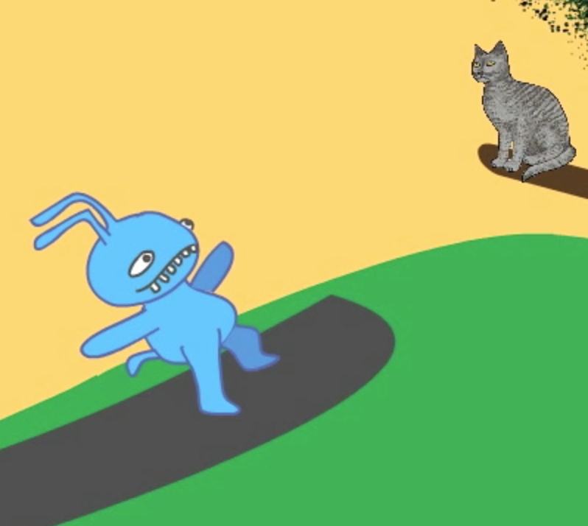

Slide 7
(Videos in your email in case they didn’t transfer)

Slide 8
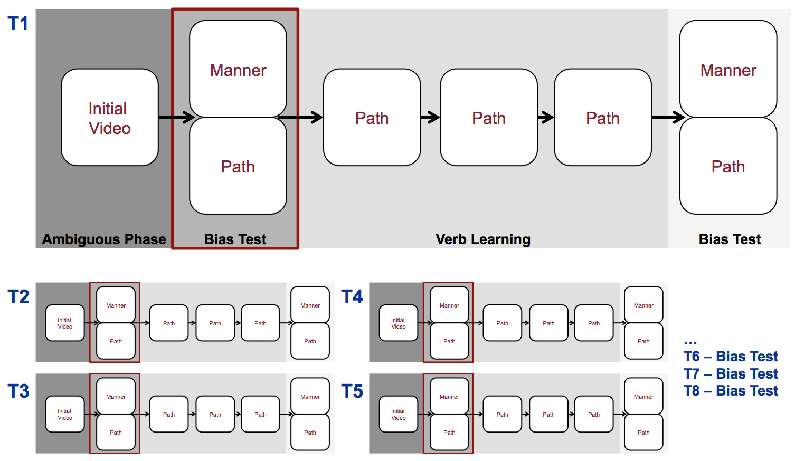
Method
4-6yo children learned 8 distinct novel verbs each in the sequence shown below (Path condition). Analysis focuses on the initial guesses for children make over the course of the training session

Slide 10
Experiment 1 – Manner/Path biases
After learning Manner verbs, children expected subsequent verbs (bias test, trials 2-8) to have manner extensions (NONSIGNIFICANT TREND)
After learning Path verbs they made more path guesses (NONSIGNIFICANT TREND)
(n=31, replication, Shafto et al. Exp. 3 with new stimuli)

Slide 11
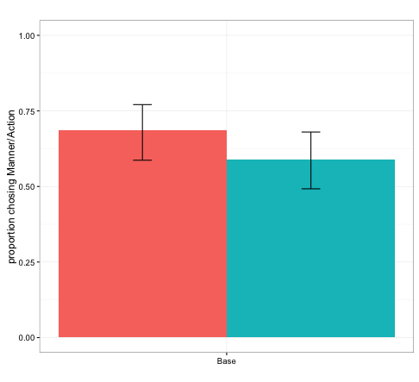

Slide 12
Experiment 2 – Action/Effect biases
Does training in one event domain lead to bias changes for verbs in another domain?

Slide 13
Experiment 2
Change-of-State events that can generalize along a dimension of action ( center, e.g. ‘combing’) or effect (right, e.g. ‘ripping’).

Slide 14
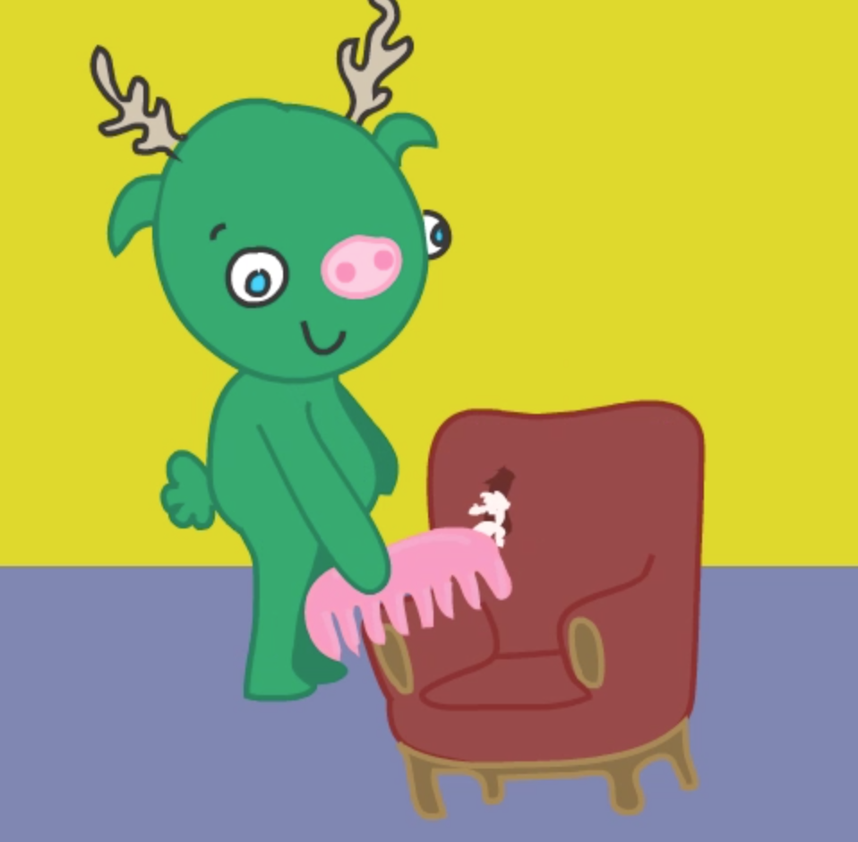
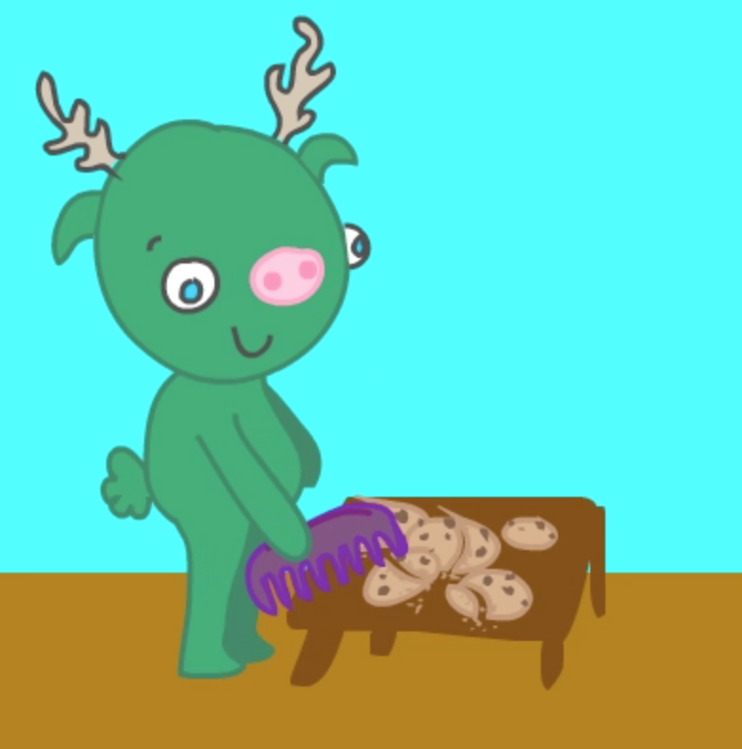
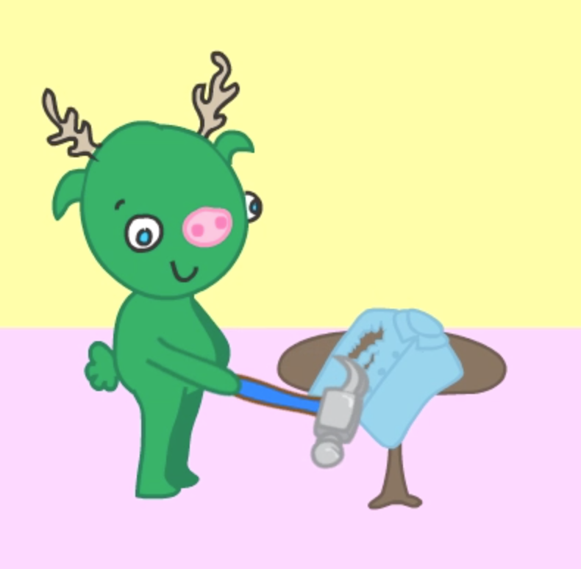

Slide 15
If early (domain-general) cognitive representations drive these biases, we should expect transfer.
If children (unlike adults) do not represent any similarities in event structure between Motion and Change-of-State domains we should see no transfer.

Slide 16
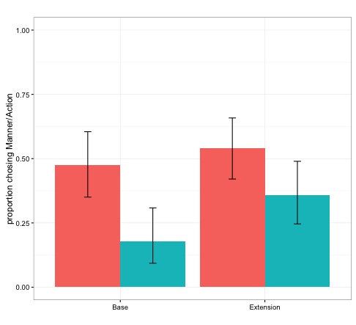

Slide 17
After learning ACTION Change-of-state verbs (trials 2-8) children then guessed that novel verbs for Motion events were MANNER verbs (trials 9-16)
After learning EFFECT Change-of-state verbs they were more likely to expect PATH motion verbs

Slide 18
Conclusions
These findings provide initial evidence that the kinds of event representations used for verb meanings involve domain-general representations of means and outcome which may be related to early cognitive models of goal-directed action

Slide 19
All project materials (Video stimuli, presentation software, anonymized data and analysis scripts are available at http://github.com/mekline/MannerPathPriming

